Slide 1
Ch 5
The Classical Civilizations Fall
Core Nations and Peripheral

Slide 2
How the “Core Civilizations” Organized their Empires
China
India
Centralization
Common language for elite
Social inequality
Localized and diverse
Used Hinduism to unify its people
Social inequality
ROME
Culture involved some of the population; not everyone partook in the Roman Culture…this made them vulnerable…Why?
Local autonomy and tolerance, as long as tribute was paid
Commercial network
Social inequality

Slide 3
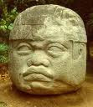
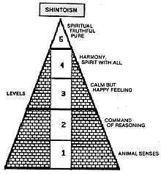
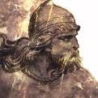
Other Civilizations (Peripheral)
Central America
Olmecs (800bce-400bce)
Advanced Agriculture
Jade, religion, calendar
Set the stage for Mayans (400ce)
Pre-Andean
Agriculture-root crops
Set the stage for the Incan Civ.
Japan
People migrated from Korea to Japan
Agricultural by 200ce
Shintoism, god of rice, etc
Complex government forming w/ Emperors by 600CE
Southeast Asia
Contact with India during this time period
Northern Europe
Celtic people lived in regional kingdoms
Some were agriculture, some seafarers
Regarded as very backward/barbaric (more on this next time period)

Slide 4
Peripheral continued…
Sub-Saharan Africa
Kush (1000bce)
Had complex societies, conquered Egyptians
They were conquered by the Axum (300bce); Axum conquered by Ethiopia (very strong)
Ethiopia:
Traded with the Mediterranean people
Ethiopia became exposed to Christianity in 300CE
Ghana
Western Africa: one of the first great African states
Some farming
More on these guys later…

Slide 5

China’s Decline (approx. 100CE)
Outside invaders
Loss of centralized control
Internal government corruption
Local rulers took over
Scholar-Gentry refused to pay taxes
Social unrest (Yellow Turbans--Daoist leaders led a rebellion against gov’t. abuses)
Loss of Confucian dedication by most and an adoption of Buddhism
Population decline due to epidemic disease
Chinese culture survived (although threatened by Buddhism)….despite this upheaval
Sui and Tang dynasties to come…

Slide 6
India Decline…approx. 500ce
Nomadic invaders
Eventually assimilated into the warrior caste
Rajput-regional princes who ruled
Hindu text were written in the vernacular
What is this? Why would they do this?
Islam will leave it’s mark on India soon…
Indian Ocean trade will change hands (Tamil merchants will lose out to the Arabs)

Slide 7

Roman Decline
Invasion of Germanic tribes
Political ineffectiveness
Economics
Many farmers huddled around the safety of a landlord
Setting the stage for feudalism/manorialism
Military: Mercenary soldiers
Social/Population declines
Loss of desire to have a family, consumed with lifestyle full of material goods, decline in literature, etc
Plague
476 CE: last Roman emperor displaced
People run to the countryside for safety
Western Europe will fall into the Middle Ages (Dark Ages)
As the West falls….the East is still strong….

Slide 8
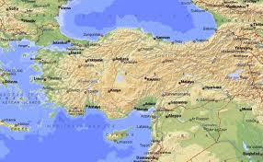
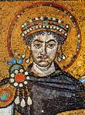
Eastern Rome AKA: Byzantium
Continued many Roman traditions
Spoke Greek, not Latin
Will split from the Western Christian Church later due to a conflict re: doctrine
Justinian (565 CE)
Laws (Justinian’s Code)
A trading crossroads
Intense cultural diffusion here…
More on this later….ch 9
Parthian(old Persian Empire) taken over by the Sassanid: extensions of the Persian’s and their culture
Then taken over by Islam…more on this in Ch. 6 and 7

Slide 9
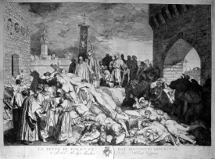

Religion in General
With epidemic disease came new interest in religion
Seeking solace and explanation
Blended old beliefs with new (syncretism)

Slide 10
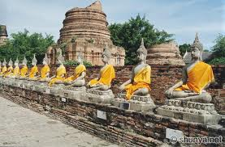
Buddhism
Spread eastward by monks to Asia
Bodhisattavas-spiritual leaders
Han fell, Buddhism arrived in China; ppl wanted an afterlife
Also took hold in Himalaya Mountains, Japan, Korea
Buddha became a god and savior; called Mahayana
Organization increased
Some syncretism regarding women in Buddhism
Buddhism not loved by all…
Confucian leaders saw it as a distraction from politics
Not compatible with family obligations required by Confucianism
Might distract from Imperial loyalty
Big impact on Korea, Vietnam, Japan, Southeast Asia too
Co Existed with many other religions/faiths

Slide 11

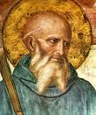

Christianity
Writings of the disciples became the New Testament (Gosples-1st 4 books)
Western Europe organized under the Pope
Becomes the tie that binds when the empire falls
Latin was the main language of the church in the West
St Augustine
Hippo, N Africa
Theologian who explained/defined doctrine
Coptic Christianity evolved as a minority in Egypt, even today
St. Benedict
Rules for monks (standardization)
Examples of Syncretism
Christmas was moved to coincide with the Winter Solstice
Moved West from the Middle East
Began as a reaction from an increasingly rigidness in Judaism
Emphasized church organization and missionaries
Traveled on the Roman road system
Jesus of Nazareth
Sent to forgive sins
Life after death
Did not intend to start a new religion
Good timing b/c people were tired of Greek and Roman gods
Followers were to put God first, not the state
Allowed men and women to worship together

